Slide 1
Who is this?

Slide 2
This is ….
Anna

Slide 3
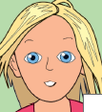
This is …..
Rose

Slide 4
This is …..
Claudia

Slide 5
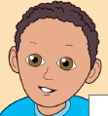
This is ….
Omar

Slide 6
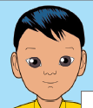
This is ……
Datu

Slide 7
This is ……
Alexis

Slide 8
What’s your name?
My name is Anna.
or
I’ m Anna.

