Slide 1
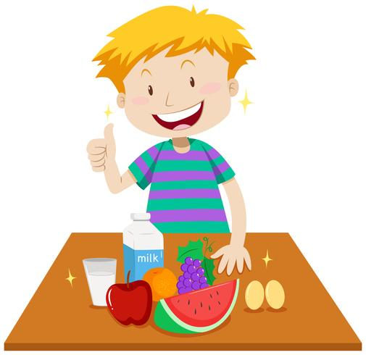
Let’s talk about food!
Countable-uncountable nouns

Slide 2
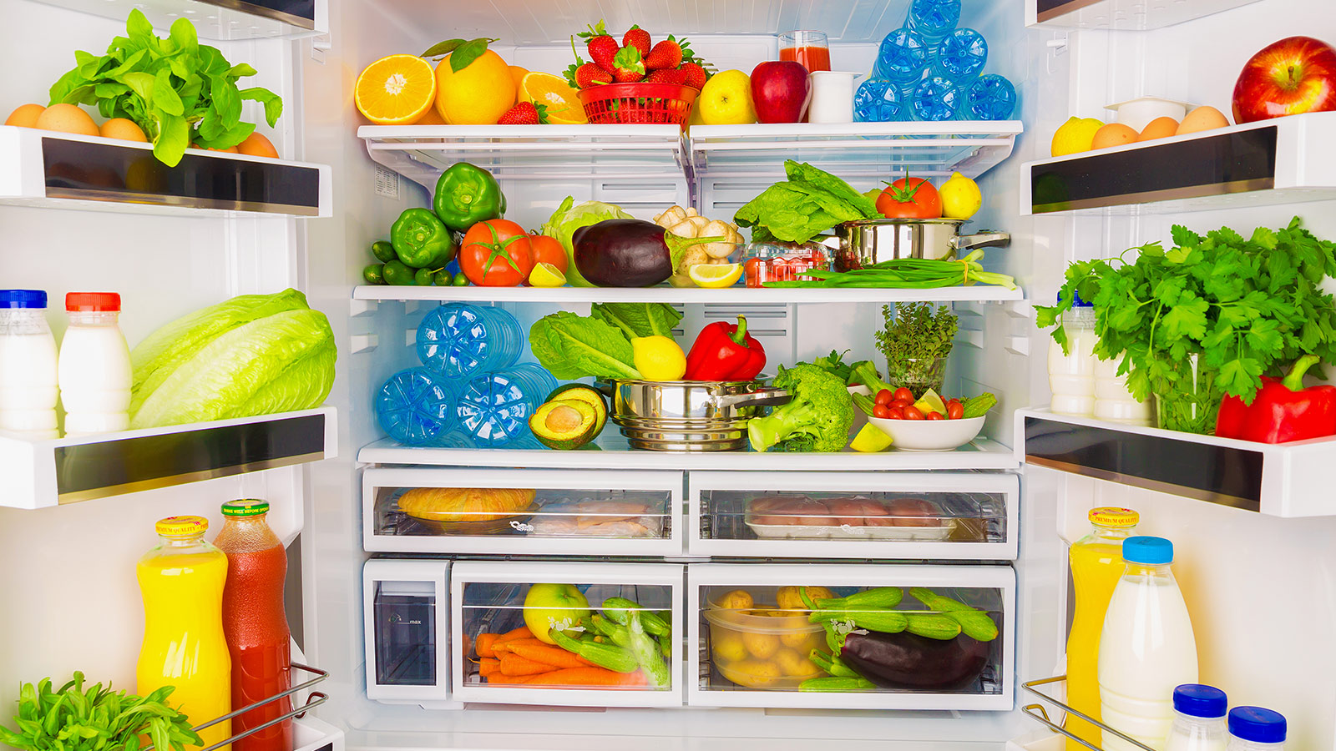
Look at this fridge! What do you like?
I like….
I don’t like…
I love…
I hate…

Slide 3


Make a shopping list with food and drinks you like!

Slide 4
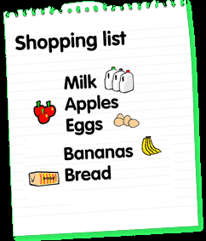
This is my shopping list! There is some milk.
There are some apples. There are some eggs. There are some bananas.
There is some bread.

Slide 5

I can say
There is a banana in the fridge.
There is an apple in the fridge.
There is an egg in the fridge.
I can’t say
There is a milk in the fridge.
There is a bread in the fridge
BUT

Slide 6
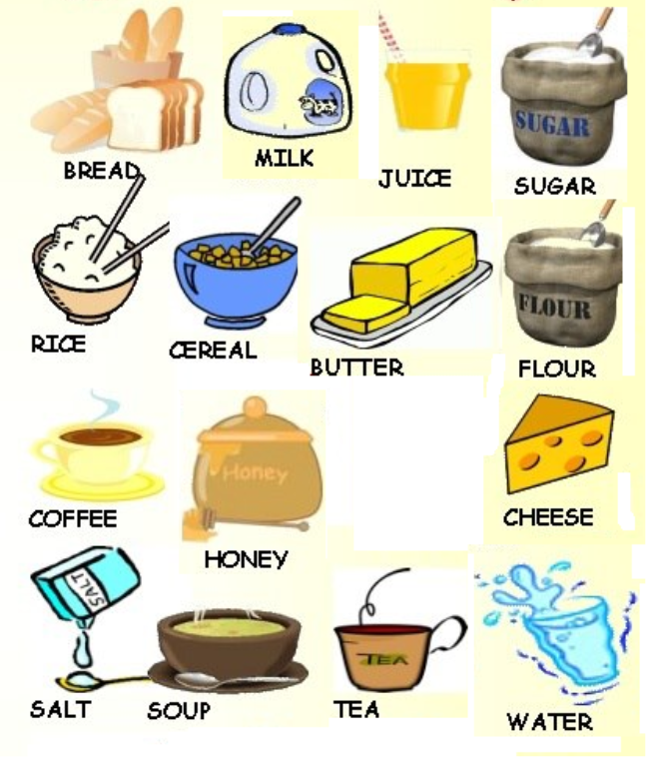

These are called uncountable nouns because we can’t count them. So we use some.

Slide 7

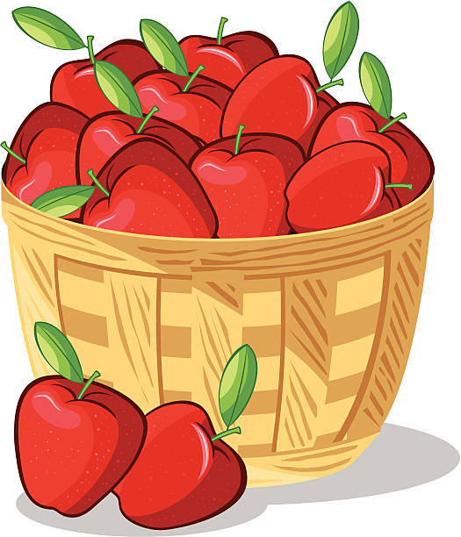
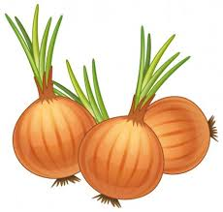
“There is some..”
There is some milk in the fridge.
There is some bread in the fridge.
“There are some..”
There are some apples in the fridge.
There are some onions in the fridge.

Slide 8
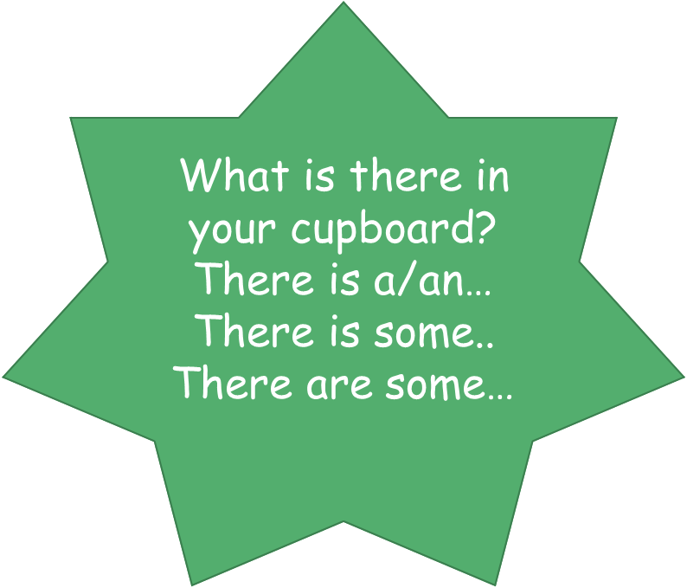


Slide 9

Try out this game!
Good luck!
https://www.eslgamesplus.com/countable-uncountable-a-an-rally/

Slide 10
BE CAREFUL!
There isn’t an apple.
There isn’t any sugar.
There aren’t any pears.

Slide 11
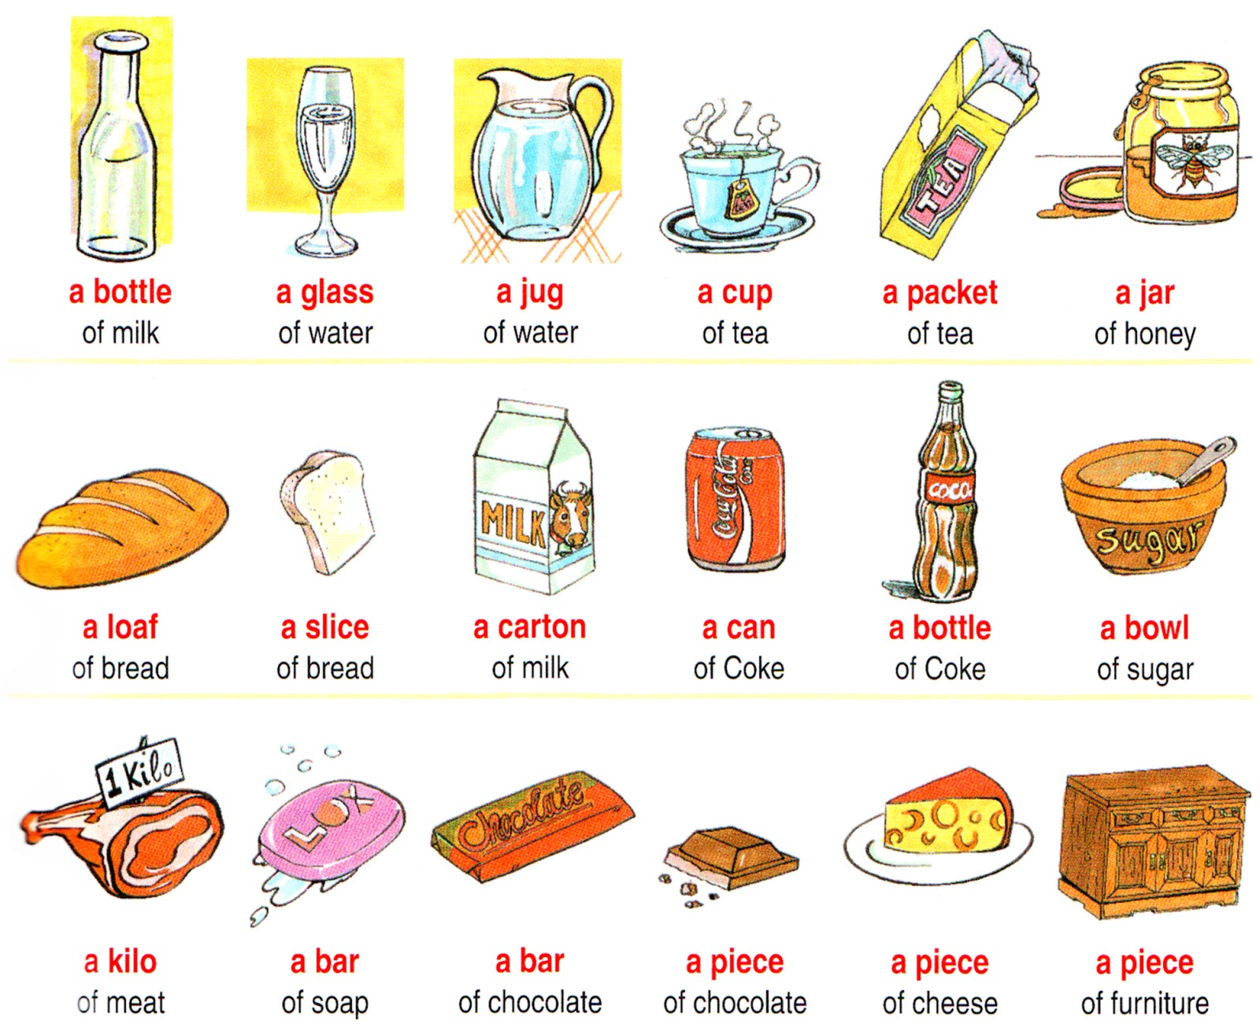

We can also use these phrases!

Slide 12
Try out this game too!
http://www.eslgamesplus.com/food-partitives-esl-fun-game-food-quantities-game/

Slide 13

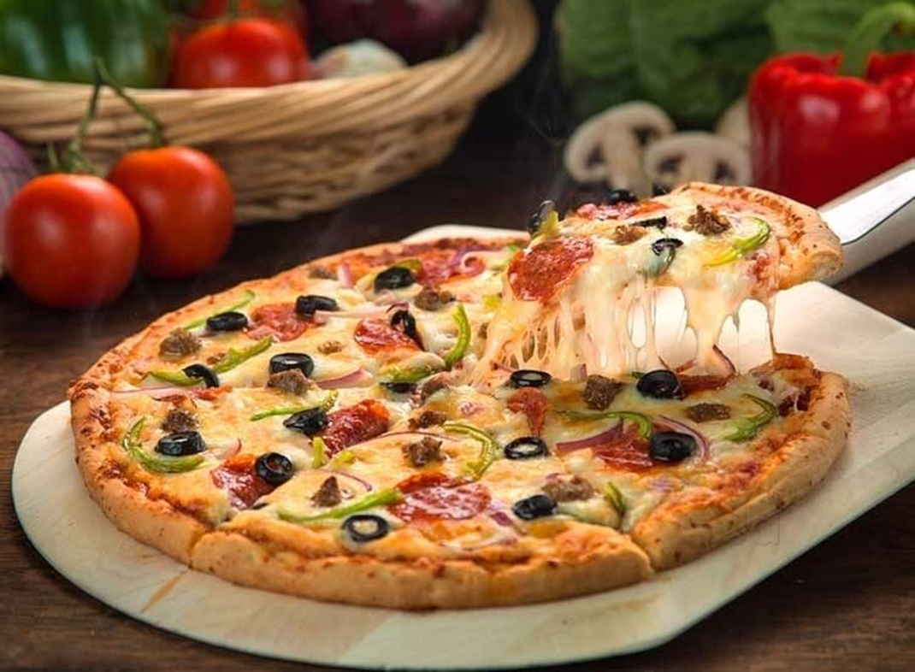
Take a look at my pizza and play the √ or x game!

Slide 14



There are some olives on the pizza.

Slide 15


Slide 16


Slide 17
There aren’t any peppers on the pizza.

Slide 20
There isn’t any pepperoni on the pizza.

Slide 23
There is some cheese on the pizza.

Slide 26
Χρησιμεσ ιστοσελιδεσ
https://www.liveworksheets.com/worksheets/en/English_as_a_Second_Language_(ESL)/Countable_and_uncountable_nouns/Countable_-_Uncountable_nouns_kx176rx (Activities 1, 4, 5)
https://www.liveworksheets.com/worksheets/en/English_as_a_Second_Language_(ESL)/Countable_and_uncountable_nouns/COUNTABLE-UNCOUNTABLE_NOUNS_ze1409dy
https://www.liveworksheets.com/worksheets/en/English_as_a_Second_Language_(ESL)/Countable_and_uncountable_nouns/COUNTABLE-UNCOUNTABLE_NOUNS_rn1413lz
https://learnenglishkids.britishcouncil.org/grammar-practice/nouns-countable-and-uncountable
https://learnenglishkids.britishcouncil.org/grammar-videos/how-many-sweets

