Slide 1
How old are you? I am 9 years old.

Slide 2
How old is she? She is 9 years old.
How old is Rose? Rose is 9 years old.

Slide 3
How old is he? He is 9 years old.
How old is Datu? Datu is 9 years old.

Slide 4
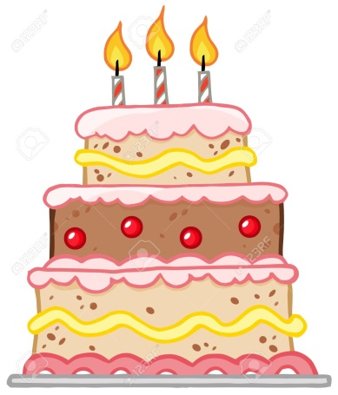
How old is she? She is 3 years old.
How old is he? He is 6 years old.

